Slide 1
Chapter 34
Introduction to JavaFX GUI Programming
Copyright © 2013 by The McGraw-Hill Companies, Inc. All rights reserved.

Slide 2
AWT → SWINGS → JavaFX
AWT
Original Framework. Has Several Limitations
SWINGS
Successful for two decades. Suitable for Enterprise Applications
JavaFX
Mobile Apps
Java’s next generation client platform and GUI framework.
provides a powerful, streamlined, flexible framework that simplifies the creation of modern, visually exciting GUIs

Slide 3
JavaFX Basic Concepts
JavaFX facilitates a more visually dynamic approach to GUIs
JavaFX Packages
The JavaFX elements are contained in packages that begin with the javafx prefix.
Examples: javafx.application, javafx.stage, javafx.scene, and javafx.scene.layout.
Beginning with JDK 9, the JavaFX packages are organized into modules, such as javafx.base, javafx.graphics, and javafx.controls.

Slide 4
JavaFX Basic Concepts..
The Stage and Scene Classes
To create a JavaFX application, you will, at minimum, add at least one Scene object to a Stage.
A stage is a container for scenes and a scene is a container for the items that comprise the scene. These elements are encapsulated in the JavaFX API by the Stage and Scene classes.
Stage is a top-level container. All JavaFX applications automatically have access to one Stage, called the primary stage. The primary stage is supplied by the run-time system when a JavaFX application is started. Although you can create other stages, for many applications, the primary stage will be the only one required.
As mentioned, Scene is a container for the items that comprise the scene. These can consist of controls, such as push buttons and check boxes, text, and graphics. To create a scene, you will add those elements to an instance of Scene.

Slide 6
JavaFX Basic Concepts..
Nodes and Scene Graphs
The individual elements of a scene are called nodes. For example, a push button control is a node.
However, nodes can also consist of groups of nodes. Furthermore, a node can have a child node. In this case, a node with a child is called a parent node or branch node. Nodes without children are terminal nodes and are called leaves.
The collection of all nodes in a scene creates what is referred to as a scene graph, which comprises a tree.
There is one special type of node in the scene graph, called the root node. This is the top-level node and is the only node in the scene graph that does not have a parent. Thus, with the exception of the root node, all other nodes have parents, and all nodes either directly or indirectly descend from the root node.
The base class for all nodes is Node. There are several other classes that are, either directly or indirectly, subclasses of Node. These include Parent, Group, Region, and Control, to name a few.

Slide 7
JavaFX Basic Concepts..
Layouts
JavaFX provides several layout panes that manage the process of placing elements in a scene.
For example, the FlowPane class provides a flow layout and the GridPane class supports a row/column grid-based layout.
Several other layouts, such as BorderPane are available. Thelayout panes are packaged in javafx.scene.layout.

Slide 8
JavaFX Basic Concepts..
The Application Class and the Life-Cycle Methods
A JavaFX application must be a subclass of the Application class, which is
packaged in javafx.application. Thus, your application class will extend
Application.
The Application class defines three life-cycle methods that your application can override. These are called init( ), start( ), and stop( ), and are shown
here, in the order in which they are called:
void init( )
abstract void start(Stage primaryStage)
void stop( )
The init( ) method is called when the application begins execution. It is used to
perform various initializations. As will be explained, however, it cannot be used to create a stage or build a scene. If no initializations are required, this method need not be overridden because an empty, default version is provided.

Slide 9
JavaFX Basic Concepts..
The Application Class and the Life-Cycle Methods..
The start( ) method is called after init( ). This is where your application begins and it can be used to construct and set the scene. Notice that it is passed a reference to a Stage object. This is the stage provided by the run-time system and is the primary stage. (You can also create other stages, but you won’t need to for simple applications.) Notice that this method is abstract. Thus, it must be overridden by your application.
When your application is terminated, the stop( ) method is called. It is here that you can handle any cleanup or shutdown chores. In cases in which no such actions are needed, an empty, default version is provided.
One other point: For a modular JavaFX application, the package that contains your main application class (that is, your subclass of Application) must be exported by its module so that it can be found by the javafx.graphics module.

Slide 10
JavaFX Basic Concepts..
Launching a JavaFX Application
To start a free-standing JavaFX application, you must call the launch( ) method
defined by Application. It has two forms. Here is the one used in this chapter:
public static void launch(String … args)
Here, args is a possibly empty list of strings that typically specify command-line
arguments. When called, launch( ) causes the application to be constructed, followed by calls to init( ) and start( ). The launch( ) method will not return until after the application has terminated. This version of launch( ) starts the subclass of Application from which launch( ) is called. The second form of launch( ) lets you specify a class other than the enclosing class to start.
Before moving on, it is necessary to make an important point: JavaFX
applications that have been packaged by using the javafxpackager tool (or its
equivalent in an IDE) do not need to include a call to launch( ). However, its
inclusion often simplifies the test/debug cycle, and it lets the program be used
without the creation of a JAR file.

Slide 11
JavaFX Application Skeleton
All JavaFX applications share the same basic skeleton. Therefore, before looking at any more JavaFX features, it will be useful to see what that skeleton looks like.
In addition to showing the general form of a JavaFX application, the skeleton also illustrates how to launch the application and demonstrates when the life-cycle methods are called.
A message noting when each life-cycle method is called is displayed on the console. The complete skeleton is shown here:

Slide 15
The Application Thread
init( ) method cannot be used to to construct a stage or scene. You also cannot create these items inside the application’s constructor. The reason is that a stage or scene must be constructed on the application thread.
However, the application’s constructor and the init( ) method are called on the main thread, also called the launcher thread. Thus, they can’t be used to construct a stage or scene.
Instead, you must use the start( ) method, as the skeleton demonstrates, to create the initial GUI because start( ) is called on the application thread.
Furthermore, any changes to the GUI currently displayed must be made from the application thread. Fortunately, in JavaFX, events are sent to your program on the application thread. Therefore, event handlers can be used to interact with the GUI.
The stop( ) method is also called on the application thread.

Slide 16
A Simple JavaFX Control: Label
The primary ingredient in most user interfaces is the control because a control enables the user to interact with the application. As you would expect, JavaFX supplies a rich assortment of controls.
The simplest control is the label because it just displays a message, which, in this example, is text. Although quite easy to use, the label is a good way to introduce the techniques needed to begin building a scene graph.
The JavaFX label is an instance of the Label class, which is packaged in
javafx.scene.control. Label inherits Labeled and Control, among other classes.
The Labeled class defines several features that are common to all labeled elements (that is, those that can contain text), and Control defines features related to all controls.

Slide 17
A Simple JavaFX Control: Label
Label defines three constructors. The one we will use here is
Label(String str)
Here, str is the string that is displayed.
Once you have created a label (or any other control), it must be added to the
scene’s content, which means adding it to the scene graph. To do this, you will first call getChildren( ) on the root node of the scene graph. It returns a list of the child nodes in the form of an ObservableList<Node>.
ObservableList is packaged in javafx.collections, and it inherits java.util.List, which means that it supports all of the features available to a list as defined by the Collections Framework. Using the returned list of child nodes, you can add the label to the list by calling add( ), passing in a reference to the label.

Slide 20
Output:

Slide 21
In the program, pay special attention to this line:
rootNode.getChildren().add(myLabel);
It adds the label to the list of children for which rootNode is the parent. Although this line could be separated into its individual pieces if necessary, you will often see it as shown here.
Before moving on, it is useful to point out that ObservableList provides a method called addAll( ) that can be used to add two or more children to the scene graph in a single call. (You will see an example of this shortly.)
To remove a control from the scene graph, call remove( ) on the ObservableList. For example,
rootNode.getChildren().remove(myLabel);
removes myLabel from the scene.

Slide 22
Using Button and Events
Although the program in the preceding section presents a simple example of using a JavaFX control and constructing a scene graph, it does not show how to handle events.
As you know, most GUI controls generate events that are handled by your
program. For example, buttons, check boxes, and lists all generate events when they are used.
One commonly used control is the button. This makes button events one of the most frequently handled. Therefore, a button is a good way to demonstrate the fundamentals of event handling in JavaFX. For this reason, the fundamentals of event handling and the button are introduced together.

Slide 23
Using Buttons and Events..
Event Basics
The base class for JavaFX events is the Event class, which is packaged in javafx.event. Event inherits java.util.EventObject, which means that JavaFX events share the same basic functionality as other Java events.
Several subclasses of Event are defined. The one that we will use here is ActionEvent. It handles action events generated by a button.
In general, JavaFX uses what is, in essence, the delegation event model approach to event handling. To handle an event, you must first register the handler that acts as a listener for the event. When the event occurs, the listener is called. It must then respond to the event and return.
Events are handled by implementing the EventHandler interface, which is also in
javafx.event. It is a generic interface with the following form:
interface EventHandler<T extends Event>
Here, T specifies the type of event that the handler will handle. It defines one
method, called handle( ), which receives the event object as a parameter. It is shown

Slide 24
Using Buttons and Events..
Event Basics…
It is shown here:
void handle(T eventObj)
Here, eventObj is the event that was generated. Typically, event handlers are implemented through anonymous inner classes or lambda expressions, but you can use stand-alone classes for this purpose if it is more appropriate to your application
(for example, if one event handler will handle events from more than one source).
Although not required by the examples in this chapter, it is sometimes useful to know the source of an event. This is especially true if you are using one handler to handle events from different sources. You can obtain the source of the event by calling getSource( ), which is inherited from java.util.EventObject. It is shown here:
Object getSource( )

Slide 25
Using Buttons and Events..
Event Basics…
Other methods in Event let you obtain the event type, determine if the event has been consumed, consume an event, fire an event, and obtain the target of the event. When an event is consumed, it stops the event from being passed to a parent handler.
One last point: In JavaFX, events are processed via an event dispatch chain.
When an event is generated, it is passed to the root node of the chain. The event is then passed down the chain to the target of the event. After the target node processes the event, the event is passed back up the chain, thus allowing parent nodes a chance to process the event, if necessary. This is called event bubbling. It is possible for a node in the chain to consume an event, which prevents it from being further processed.

Slide 26
Using Buttons and Events..
Introducing Button Control
In JavaFX, the push button control is provided by the Button class, which is in
javafx.scene.control. Button inherits a fairly long list of base classes that include ButtonBase, Labeled, Region, Control, Parent, and Node. If you examine the API documentation for Button, you will see that much of its functionality comes from its base classes. Furthermore, it supports a wide array of options.
However, here we will use its default form. Buttons can contain text, graphics, or both. In this chapter, we will use text-based buttons. An example of a graphics-based button is shown in the
next chapter.
Button defines three constructors. The one we will use is shown here:
Button(String str)
In this case, str is the message that is displayed in the button.

Slide 27
Using Buttons and Events..
Introducing Button Control..
When a button is pressed, an ActionEvent is generated. ActionEvent is packaged in javafx.event. You can register a listener for this event by using setOnAction( ), which has this general form:
final void setOnAction(EventHandler<ActionEvent> handler)
Here, handler is the handler being registered. As mentioned, often you will use an anonymous inner class or lambda expression for the handler. The setOnAction( ) method sets the property onAction, which stores a reference to the handler.
As with all other Java event handling, your handler must respond to the event as fast as possible and then return. If your handler consumes too much time, it will noticeably slow down the application. For lengthy operations, you must use a separate thread ofexecution.

Slide 31
Sample Output

Slide 36
Drawing Directly on a Canvas

Slide 37
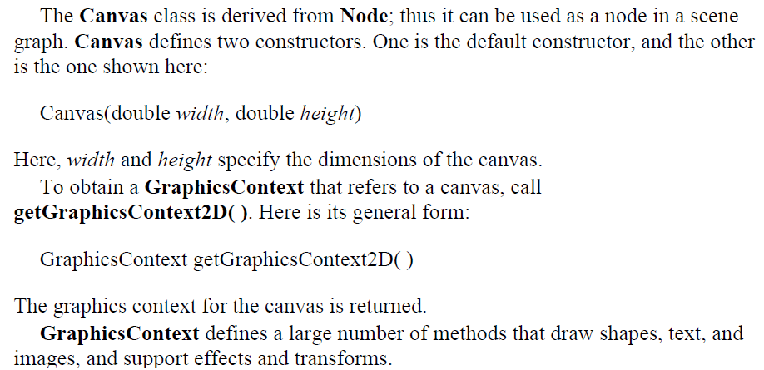

Slide 41
Example program to demonstrate Drawing

Slide 46
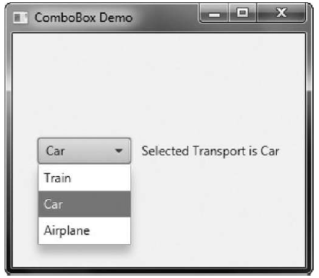
ComboBox

Slide 47
ComboBox
A combo box displays one selection, but it will also display
a drop-down list that allows the user to select a different item.
ComboBox inherits ComboBoxBase which provides much of its functionality.
Unlike the ListView, which can allow multiple selections,
ComboBox is designed for single-selection.
ComboBox is a generic class that is declared like this:
class ComboBox<T>
Here, T specifies the type of entries. Often, these are entries of type String, but other types are also allowed.

Slide 48
ComboBox constructors
The default constructor creates an empty ComboBox.
ComboBox (ObservableList<T>list)
list specifies a list of the items that will be displayed
It is an object of type ObservableList, which defines a list of observable objects.
ObservableList inherits java.util.List.
An easy way to create an ObservableList is to use the factory method
observableArrayList( ), which is a static method defined by the FXCollections class.

Slide 49
Events Generated by Combobox
A ComboBox generates an action event when its selection changes
It will also generate a change event
Alternatively, it is also possible to ignore events and simply obtain the current selection when needed
To obtain the current selection by calling getValue( ), shown here:
final T getValue( )
If the value of a combo box has not yet been set (by the user or under program control), then getValue( ) will return null.
To set the value of a ComboBox under program control, call setValue( ):
final void setValue(T newVal)

Slide 50
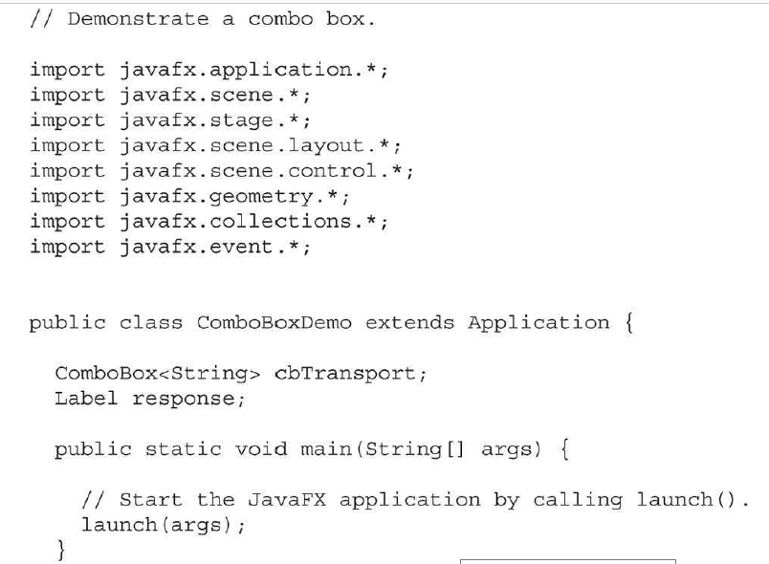

Slide 51
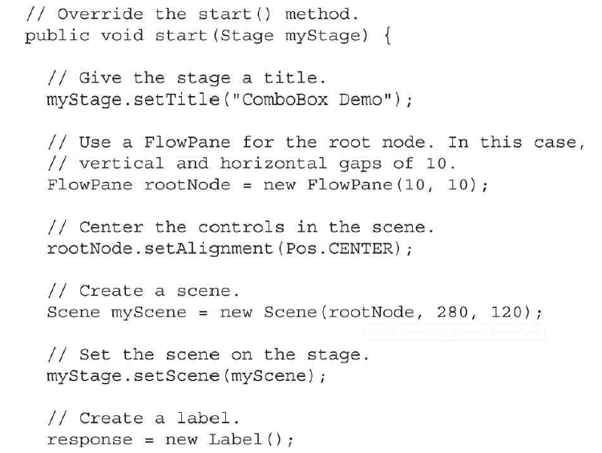

Slide 52
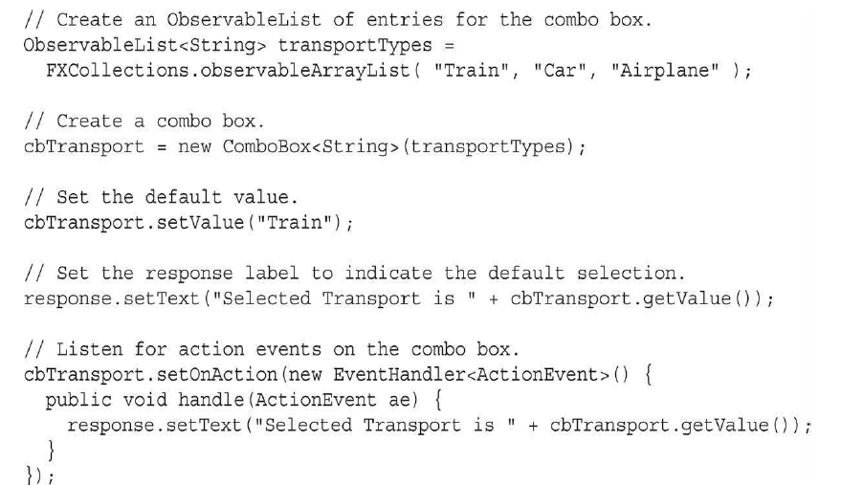

Slide 53
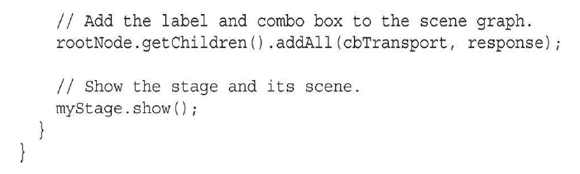

Slide 54
ToggleButton
A toggle button looks just like a push button, but it acts differently because it has two states: pushed and released.
That is, when you press a toggle button, it stays pressed rather than popping back up as a regular push button does. When you press the toggle button a second time, it releases (pops up).
Therefore, each time a toggle button is pushed, it toggles between these two states.
In JavaFX, a toggle button is encapsulated in the ToggleButton class. Like Button, ToggleButton is also derived from ButtonBase. It implements the Toggle interface, which defines functionality common to all types of two-state buttons.

Slide 55
ToggleButton defines three constructors.
ToggleButton(String str)
Here, str is the text displayed in the button.
When the button is pressed, the option is selected. When the button is released, the option is deselected. For this reason, a program usually needs to determine the toggle button’s state.
To do this, use the isSelected( ) method, shown here:
final boolean isSelected( )
It returns true if the button is pressed and false otherwise.

Slide 56
// Demonstrate a toggle button.
import javafx.application.*;
import javafx.scene.*;
import javafx.stage.*;
import javafx.scene.layout.*;
import javafx.scene.control.*;
import javafx.event.*;
import javafx.geometry.*;
public class ToggleButtonDemo extends Application {
ToggleButton tbOnOff;
Label response;
public static void main(String[] args) {
// Start the JavaFX application by calling launch().
launch(args);
}
// Override the start() method.

Slide 57
public void start(Stage myStage) {
// Give the stage a title.
myStage.setTitle("Demonstrate a Toggle Button");
// Use a FlowPane for the root node. In this case,
// vertical and horizontal gaps of 10.
FlowPane rootNode = new FlowPane(10, 10);
// Center the controls in the scene.
rootNode.setAlignment(Pos.CENTER);
// Create a scene.
Scene myScene = new Scene(rootNode, 220, 120);
// Set the scene on the stage.
myStage.setScene(myScene);
// Create a label.
response = new Label("Push the Button.");
// Create the toggle button.
tbOnOff = new ToggleButton("On/Off");

Slide 58
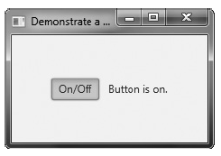
// Handle action events for the toggle button.
tbOnOff.setOnAction(new EventHandler<ActionEvent>() {
public void handle(ActionEvent ae) {
if(tbOnOff.isSelected()) response.setText("Button is on.");
else response.setText("Button is off.");
}
});
// Add the label and buttons to the scene graph.
rootNode.getChildren().addAll(tbOnOff, response);
// Show the stage and its scene.
myStage.show();
}
}
When the button is pressed, isSelected( ) returns true.
When the button is released, isSelected( ) returns false.

Slide 59
RadioButton
Another type of button provided by JavaFX is the radio button.
Radio buttons are a group of mutually exclusive buttons, in which only one button can be selected at any one time. They are supported by the RadioButton class, which extends both ButtonBase and ToggleButton.
It also implements the Toggle interface.
Thus, a radio button is a specialized form of a toggle button.
They are the primary control employed when the user must select only one option among several alternatives.
To create a radio button, we will use the following constructor:
RadioButton(String str)
Here, str is the label for the button.
Like other buttons, when a RadioButton is used, an action event is generated.
Radio buttons must be configured into a group. Only one of the buttons in the group can be selected at any time.

Slide 60
A button group is created by the ToggleGroup class, which is packaged in javafx.scene.control. ToggleGroup provides only a default constructor.
Radio buttons are added to the toggle group by calling the setToggleGroup( ) method, defined by ToggleButton, on the button. It is shown here:
final void setToggleGroup(ToggleGroup tg)
Here, tg is a reference to the toggle button group to which the button is added.
In general, when radio buttons are used in a group, one of the buttons is selected when
the group is first displayed in the GUI. Here are two ways to do this.
First, you can call setSelected( ) on the button that you want to select. It is defined by
ToggleButton (which is a superclass of RadioButton). It is shown here:
final void setSelected(boolean state)
If state is true, the button is selected. Otherwise, it is deselected.
Although the button is selected, no action event is generated.
A second way to initially select a radio button is to call fire( ) on the button. It is
shown here: void fire( )
This method results in an action event being generated for the button if the button was
previously not selected.

Slide 61
// This program responds to the action events generated
// by a radio button selection. It also shows how to
// fire the button under program control.
import javafx.application.*;
import javafx.scene.*;
import javafx.stage.*;
import javafx.scene.layout.*;
import javafx.scene.control.*;
import javafx.event.*;
import javafx.geometry.*;
public class RadioButtonDemo extends Application {
Label response;
public static void main(String[] args) {
// Start the JavaFX application by calling launch().
launch(args);
}
// Override the start() method.

Slide 62
public void start(Stage myStage) {
// Give the stage a title.
myStage.setTitle("Demonstrate Radio Buttons");
// Use a FlowPane for the root node. In this case,
// vertical and horizontal gaps of 10.
FlowPane rootNode = new FlowPane(10, 10);
// Center the controls in the scene.
rootNode.setAlignment(Pos.CENTER);
// Create a scene.
Scene myScene = new Scene(rootNode, 220, 120);
// Set the scene on the stage.
myStage.setScene(myScene);
// Create a label that will report the selection.
response = new Label("");
// Create the radio buttons.
RadioButton rbTrain = new RadioButton("Train");
RadioButton rbCar = new RadioButton("Car");
RadioButton rbPlane = new RadioButton("Airplane");

Slide 63
// Create a toggle group.
ToggleGroup tg = new ToggleGroup();
// Add each button to a toggle group.
rbTrain.setToggleGroup(tg);
rbCar.setToggleGroup(tg);
rbPlane.setToggleGroup(tg);
// Handle action events for the radio buttons.
rbTrain.setOnAction(new EventHandler<ActionEvent>() {
public void handle(ActionEvent ae) {
response.setText("Transport selected is train.");
}
});
rbCar.setOnAction(new EventHandler<ActionEvent>() {
public void handle(ActionEvent ae) {
response.setText("Transport selected is car.");
}
});

Slide 64
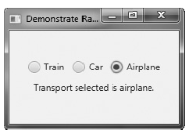
rbPlane.setOnAction(new EventHandler<ActionEvent>() {
public void handle(ActionEvent ae) {
response.setText("Transport selected is airplane.");
}
});
// Fire the event for the first selection. This causes
// that radio button to be selected and an action event for that button to occur.
rbTrain.fire();
// Add the label and buttons to the scene graph.
rootNode.getChildren().addAll(rbTrain, rbCar, rbPlane, response);
// Show the stage and its scene.
myStage.show();
}
}

Slide 65
CheckBox
In JavaFX, the check box is encapsulated by the CheckBox class. Its immediate superclass is ButtonBase. Thus it is a special type of button.
CheckBox supports three states. The first two are checked or unchecked, as you would expect, and this is the default behavior. The third state is indeterminate (also called undefined).
Here is the CheckBox constructor that we will use:
CheckBox(String str)
It creates a check box that has the text specified by str as a label. As with other buttons, a CheckBox generates an action event when it is selected.
The following program demonstrates check boxes. It displays four check boxes that represent different types of computers. They are labeled Smartphone, Tablet, Notebook, and Desktop. Each time a check-box state changes, an action event is generated. It is handled by displaying the new state (selected or cleared) and by displaying a list of all selected boxes.

Slide 66
// Demonstrate Check Boxes.
import javafx.application.*;
import javafx.scene.*;
import javafx.stage.*;
import javafx.scene.layout.*;
import javafx.scene.control.*;
import javafx.event.*;
import javafx.geometry.*;
public class CheckboxDemo extends Application {
CheckBox cbSmartphone;
CheckBox cbTablet;
CheckBox cbNotebook;
CheckBox cbDesktop;
Label response;
Label selected;
String computers;

Slide 67
public static void main(String[] args) {
// Start the JavaFX application by calling launch().
launch(args);
}
// Override the start() method.
public void start(Stage myStage) {
// Give the stage a title.
myStage.setTitle("Demonstrate Check Boxes");
// Use a vertical FlowPane for the root node. In this case,
// vertical and horizontal gaps of 10.
FlowPane rootNode = new FlowPane(Orientation.VERTICAL, 10, 10);
// Center the controls in the scene.
rootNode.setAlignment(Pos.CENTER);
// Create a scene.
Scene myScene = new Scene(rootNode, 230, 200);
// Set the scene on the stage.
myStage.setScene(myScene);
Label heading = new Label("What Computers Do You Own?");

Slide 68
// Create a label that will report the state change of a check box.
response = new Label("");
// Create a label that will report all selected check boxes.
selected = new Label("");
// Create the check boxes.
cbSmartphone = new CheckBox("Smartphone");
cbTablet = new CheckBox("Tablet");
cbNotebook = new CheckBox("Notebook");
cbDesktop = new CheckBox("Desktop");
// Handle action events for the check boxes.
cbSmartphone.setOnAction(new EventHandler<ActionEvent>() {
public void handle(ActionEvent ae) {
if(cbSmartphone.isSelected())
response.setText("Smartphone was just selected.");
else
response.setText("Smartphone was just cleared.");
showAll();
} });

Slide 69
cbTablet.setOnAction(new EventHandler<ActionEvent>() {
public void handle(ActionEvent ae) {
if(cbTablet.isSelected())
response.setText("Tablet was just selected.");
else
response.setText("Tablet was just cleared.");
showAll();
}
});
cbNotebook.setOnAction(new EventHandler<ActionEvent>() {
public void handle(ActionEvent ae) {
if(cbNotebook.isSelected())
response.setText("Notebook was just selected.");
else
response.setText("Notebook was just cleared.");
showAll();
}
});

Slide 70
cbDesktop.setOnAction(new EventHandler<ActionEvent>() {
public void handle(ActionEvent ae) {
if(cbDesktop.isSelected())
response.setText("Desktop was just selected.");
else
response.setText("Desktop was just cleared.");
showAll();
}
});
// Add controls to the scene graph.
rootNode.getChildren().addAll(heading, cbSmartphone, cbTablet,
cbNotebook, cbDesktop, response, selected);
// Show the stage and its scene.
myStage.show();
showAll();
}

Slide 71
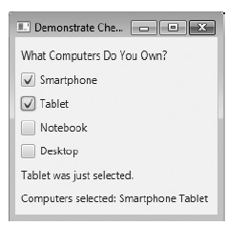
// Update and show the selections.
void showAll() {
computers = "";
if(cbSmartphone.isSelected())
computers = "Smartphone ";
if(cbTablet.isSelected())
computers += "Tablet ";
if(cbNotebook.isSelected())
computers += "Notebook ";
if(cbDesktop.isSelected())
computers += "Desktop";
selected.setText("Computers selected: " + computers);
}
}
Sample output is shown here:

Slide 72
ListView
A ListView can display a list of entries from which you can select one or more. Scrollbars are automatically added when the number of items in the list exceeds the number that can be displayed within the control’s dimensions. ListView is a generic class that is declared like this:
class ListView<T>
Here, T specifies the type of entries stored in the list view. Often, these are entries of type String, but other types are also allowed.
Here is the ListView constructor that we will use:
ListView(ObservableList<T> list)
The list of items to be displayed is specified by list. It is an object of type ObservableList. ObservableList supports a list of objects.
By default, a ListView allows only one item in the list to be selected at any one time. You can allow multiple selections by changing the selection mode, but we will use the default, single-selection mode.

Slide 73
To create an ObservableList for use in a ListView is to use the factory method observableArrayList( ), which is a static method defined by the FXCollections class (which is packaged in javafx.collections).
static <E> ObservableList<E> observableArrayList(E ... elements)
In this case, E specifies the type of elements, which are passed via elements.
to set the preferred height and/or width, size:
final void setPrefHeight(double height)
final void setPrefWidth(double width)
void setPrefSize(double width, double height)
you can monitor the list for changes by registering a change listener. This lets you
respond each time the user changes a selection in the list. A change listener is supported by the ChangeListener interface, which is packaged in javafx.beans.value. The ChangeListener interface defines only one method, called changed( ). It is shown here:
void changed(ObservableValue<? extends T> changed, T oldVal, T newVal)
In this case, changed is the instance of ObservableValue<T> which encapsulates an object
that can be watched for changes. The oldVal and newVal parameters pass the previous value and the new value, respectively. Thus, in this case, newVal holds a reference to the list item that has just been selected.

Slide 74
To listen for change events, you must first obtain the selection model used by the
ListView. This is done by calling getSelectionModel( ) on the list. It is shown here:
final MultipleSelectionModel<T> getSelectionModel( )
It returns a reference to the model.
Using the model returned by getSelectionModel( ), you will obtain a reference to the
selected item property that defines what takes place when an element in the list is selected.
This is done by calling selectedItemProperty( ), shown next:
final ReadOnlyObjectProperty<T> selectedItemProperty( )
You will add the change listener to this property by using the addListener( ) method on the returned property. The addListener( ) method is shown here:
void addListener(ChangeListener<? super T> listener)
In this case, T specifies the type of the property.
The following example creates a list view that displays a list of computer types, allowing the user to select one. When one is chosen, the selection is displayed.

Slide 75
// Demonstrate a list view.
import javafx.application.*;
import javafx.scene.*;
import javafx.stage.*;
import javafx.scene.layout.*;
import javafx.scene.control.*;
import javafx.geometry.*;
import javafx.beans.value.*;
import javafx.collections.*;
public class ListViewDemo extends Application {
Label response;
public static void main(String[] args) {
// Start the JavaFX application by calling launch().
launch(args);
}
// Override the start() method.

Slide 76
public void start(Stage myStage) {
// Give the stage a title.
myStage.setTitle("ListView Demo");
// Use a FlowPane for the root node. In this case,
// vertical and horizontal gaps of 10.
FlowPane rootNode = new FlowPane(10, 10);
// Center the controls in the scene.
rootNode.setAlignment(Pos.CENTER);
// Create a scene.
Scene myScene = new Scene(rootNode, 200, 120);
// Set the scene on the stage.
myStage.setScene(myScene);
// Create a label.
response = new Label("Select Computer Type");
// Create an ObservableList of entries for the list view.
ObservableList<String> computerTypes =
FXCollections.observableArrayList("Smartphone", "Tablet", "Notebook", "Desktop" );

Slide 77
// Create the list view.
ListView<String> lvComputers = new ListView<String>(computerTypes);
// Set the preferred height and width.
lvComputers.setPrefSize(100, 70);
// Get the list view selection model.
MultipleSelectionModel<String> lvSelModel = lvComputers.getSelectionModel();
// Use a change listener to respond to a change of selection within a list view.
lvSelModel.selectedItemProperty().addListener( new ChangeListener<String>() {
public void changed(ObservableValue<? extends String> changed,
String oldVal, String newVal) {
// Display the selection.
response.setText("Computer selected is " + newVal);
}
});
// Add the label and list view to the scene graph.
rootNode.getChildren().addAll(lvComputers, response);

Slide 78
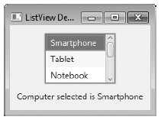
// Show the stage and its scene.
myStage.show();
}
}
Sample output is shown here.
Notice that a vertical scroll bar has been included so that the list can be scrolled to see all of its entries.

